Slide 1
Employee Performance Prediction(resigned/not)

Slide 2
Problem Statement:
The goal of our project is to build a predictive model to identify employees who are likely to resign from the company. The dataset contains various features related to employee demographics, job roles, and performance metrics. The target variable, "Resigned," is a binary classification label, where True indicates that the employee has resigned, and False indicates that the employee is still employed. The objective is to leverage this data to predict the likelihood of future resignations, helping the company take proactive measures in retaining high-value employees.

Slide 3
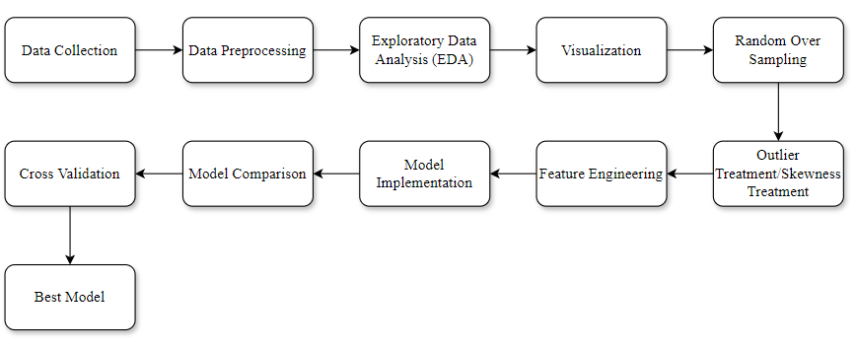
Flow Diagram:

Slide 4
Data And Cleaning:
Attributes:
The shape of the dataset is (100,000, 20), indicating 100,000 observations (rows) and 20 attributes (columns).
Dependent Variable:
Resigned: Boolean variable Indicating if the employee has resigned (True or False).
Missing Values Treatment:
No missing values

Slide 5
Data And Cleaning:
Converting Data Types:
Resigned column: Converted from Boolean to integer(Label Encoder Method), where:
True = 1 (Employee resigned)
False = 0 (Employee did not resign)
Duplicates:
No duplicate records detected

Slide 6
Basic Data Frame:
Model Name | Accuracy (%) | Precision | Recall | F1 Score
Logistic Regression | 90.43 | 0.00 | 0.00 | 0.00
Decision Tree | 80.01 | 0.12 | 0.09 | 0.10
Random Forest | 90.43 | 0.00 | 0.00 | 0.00
K-Nearest Neighbors | 90.43 | 0.00 | 0.00 | 0.00
Support Vector Machine | 90.43 | 0.00 | 0.00 | 0.00
Naive Bayes | 90.43 | 0.00 | 0.00 | 0.00
Decision Tree performs best compared to all other models, showing non-zero values in precision, recall, and F1-score.

Slide 7
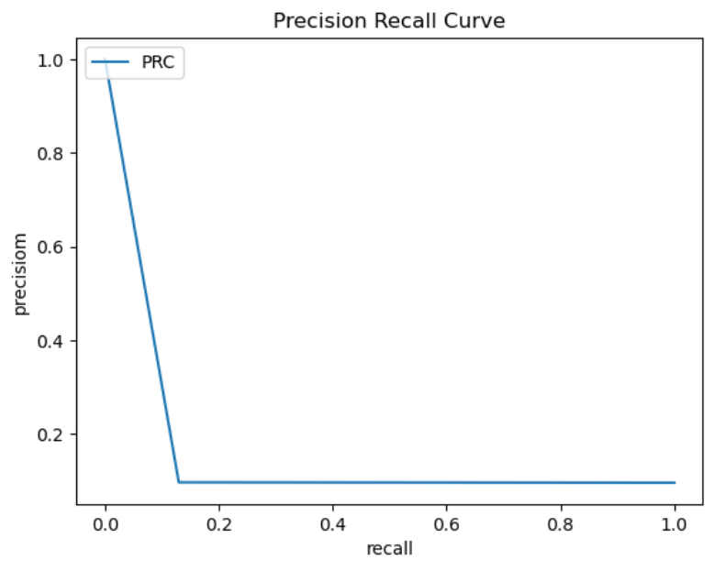
Best Fitted Model Graph:

Slide 8
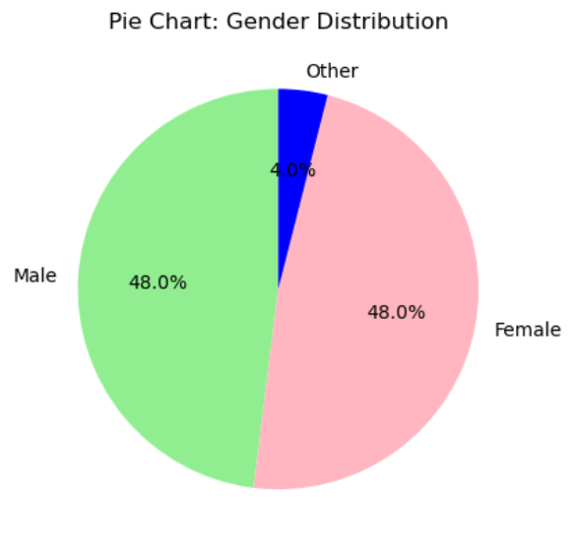
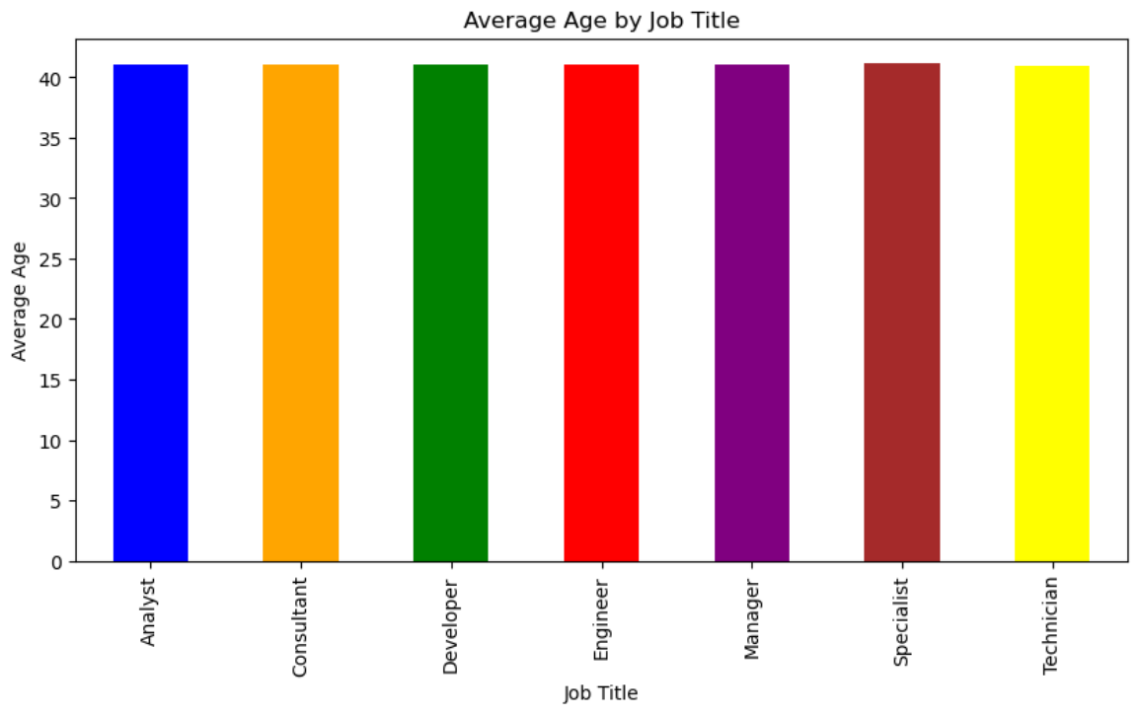
EDA-Visualization:
Gender distribution shows a balanced workforce with 48% male, 48% female, and 4% identifying as others.
Across all job titles, employees have a consistent average age, indicating no significant age disparity by role.

Slide 9
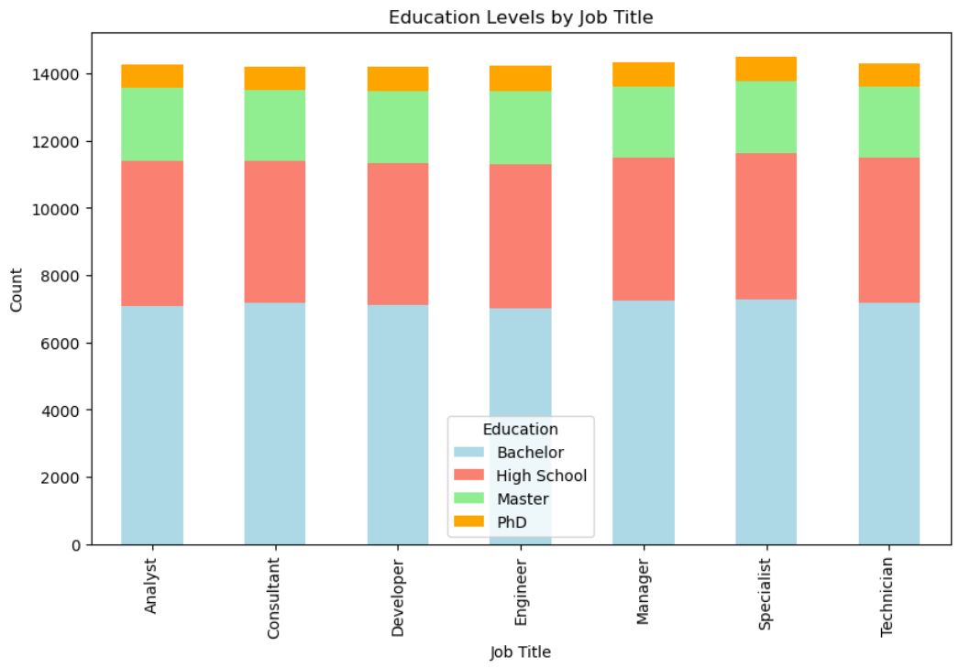
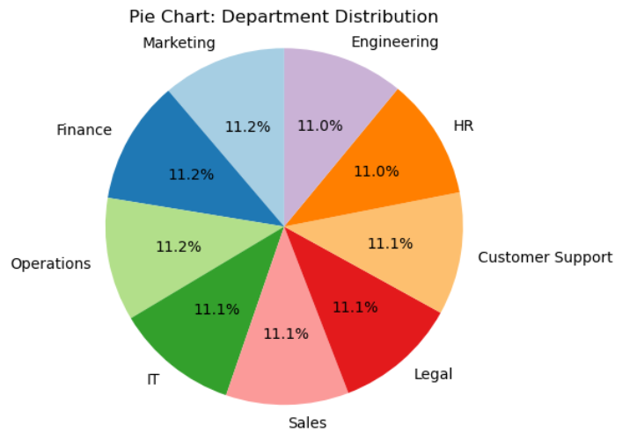
EDA-Visualization:
The department distribution is well-balanced, with all departments contributing between 11.0% and 11.2% to the workforce.
Across all job titles, the majority of employees hold a Bachelor's degree, followed by High School, Master's, and PhD qualifications in smaller proportions.

Slide 10
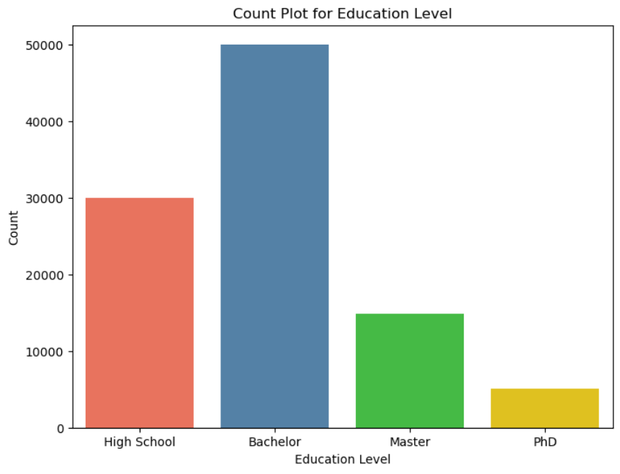
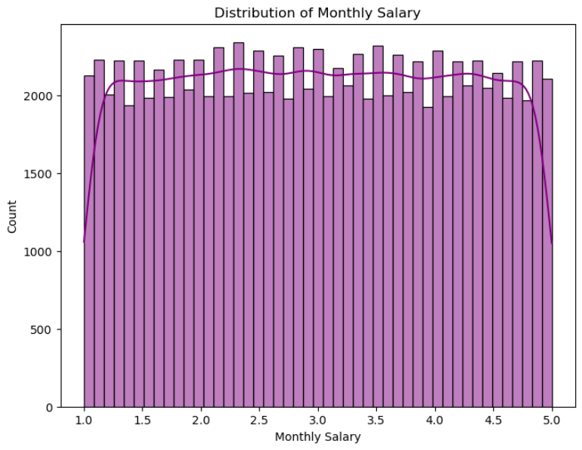
EDA-Visualization:
The majority of employees hold a Bachelor's degree, followed by High School, Master's, and PhD qualifications, with different bar colors representing each level. ​
The Employee Satisfaction Score is evenly distributed between 1.0 and 5.0, showing a uniform spread across the scores.

Slide 11
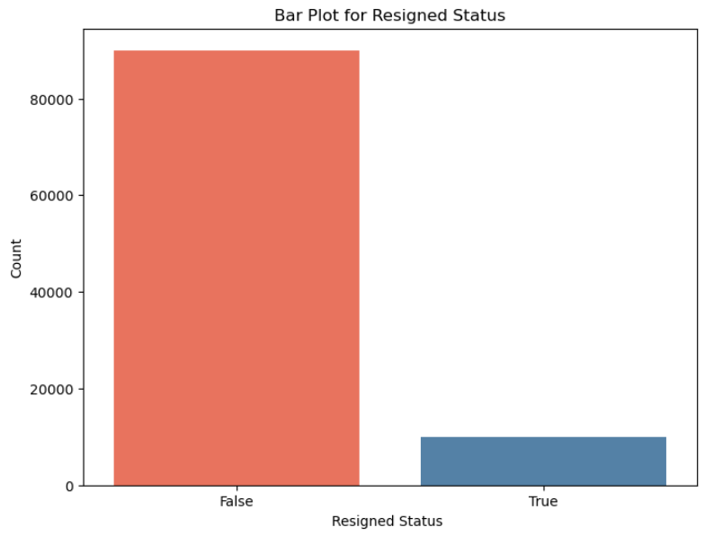
EDA
Majority of employees have not resigned, with a significant imbalance between those who stayed and those who resigned.

Slide 12
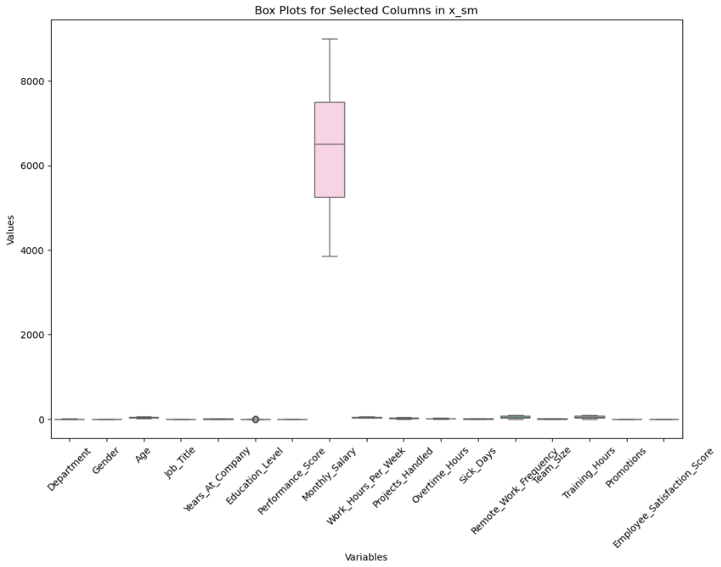
Data Boxplot:
Box plot reveals no significant outliers, with most variables tightly clustered near zero except for Monthly Salary.

Slide 13
Outliers/skewness treatment:
No outliers and skewness identified.
Class imbalance:
Treated using RandomOverSampler from `imblearn.over_sampling`.

Slide 14
Data Frame – 2:
Model Name | Accuracy (%) | Precision | Recall | F1 Score
Logistic Regression | 50.38 | 0.47 | 0.50 | 0.49
Decision Tree | 93.77 | 0.99 | 0.89 | 0.94
Random Forest | 99.97 | 0.99 | 1.00 | 0.99
K-Nearest Neighbors | 63.67 | 0.71 | 0.61 | 0.66
Support Vector Machine | 49.69 | 0.00 | 0.00 | 0.00
Naive Bayes | 50.56 | 0.51 | 0.50 | 0.51
The Decision Tree model is the best performer with 93.78% accuracy, while the Random Forest model, despite its 99.97% accuracy, is likely overfitted.

Slide 15
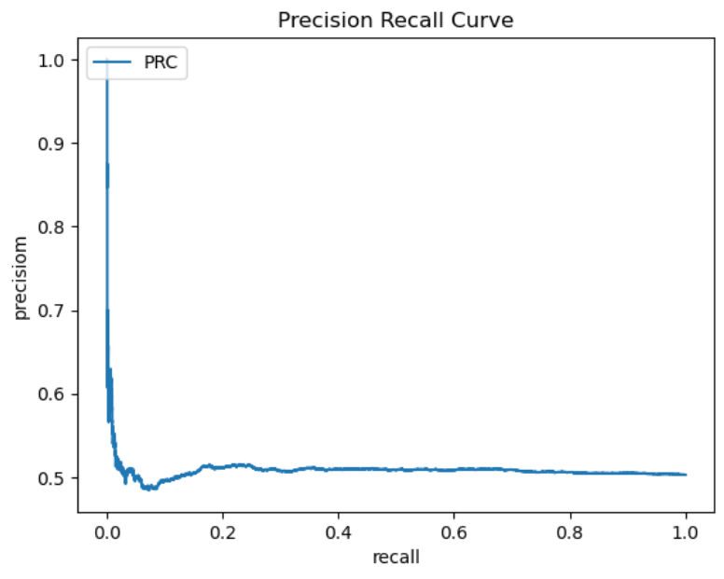
Best Fitted Model Graph:

Slide 16
Feature Engineering DataFrame-3:
Model Name | Accuracy | Precision | Recall | F1 Score
Decision Tree | 93.69 | 0.99 | 0.94 | 0.94
After feature engineering, the Decision Tree model achieved an accuracy of 93.69%, with a precision of 0.99 and a recall of 0.94, resulting in a high F1 score of 0.96, showcasing its robustness and reliability in classification tasks.

Slide 17
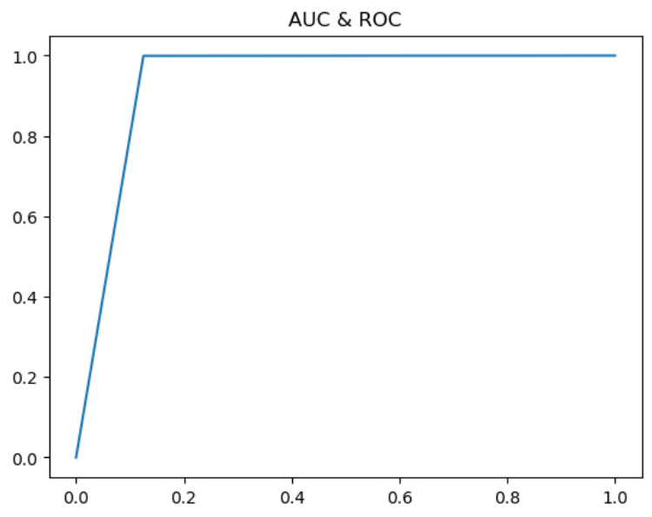
Best Fitted Model Graph:

Slide 18
Cross Validation And Final Conclusion:
Consistent performance with cross-validation scores ranging from 0.9339 to 0.9408
Mean cross-validation accuracy of 0.94
Overall accuracy: 93.69%
High precision: 0.99
High recall: 0.94
F1 score: 0.96
The Decision Tree model delivers high accuracy, precision, and recall, making it the most effective classifier for our project.

Slide 19
Drawbacks:
Overfitting Risk: High accuracy in Decision Tree may lead to overfitting and poor generalization.
Synthetic Data: Oversampling may introduce unrealistic data, affecting model robustness.
Feature Engineering Bias: Model performance is highly dependent on the selected features.
Scalability Issues: Decision Trees can struggle with large datasets, affecting efficiency.
Residual Class Imbalance: Even with oversampling, the model may still misclassify minority classes.

Slide 20
Thank You

